Slide 1
Tries
Session 10
Henry Lucky, S.Kom., M.Kom.

Slide 2
Learning Objectives
Session 10
At the end of this session, students will be able to:
Explain the concept of Tries, its operations and its applications.
Illustrate the operation of Tries.
Apply Tries using C.

Slide 3
Subtopics
Session 10
Tries Concept & Application
Tries Operations

Slide 4
Learning outcomes
Session 10
The learning outcomes associated with this topic:
LO 1: Explain the concept of data structures and its usage in Computer Science
LO 2: Illustrate any learned data structure and its usage in application
LO 3: Apply data structures using C

Slide 5
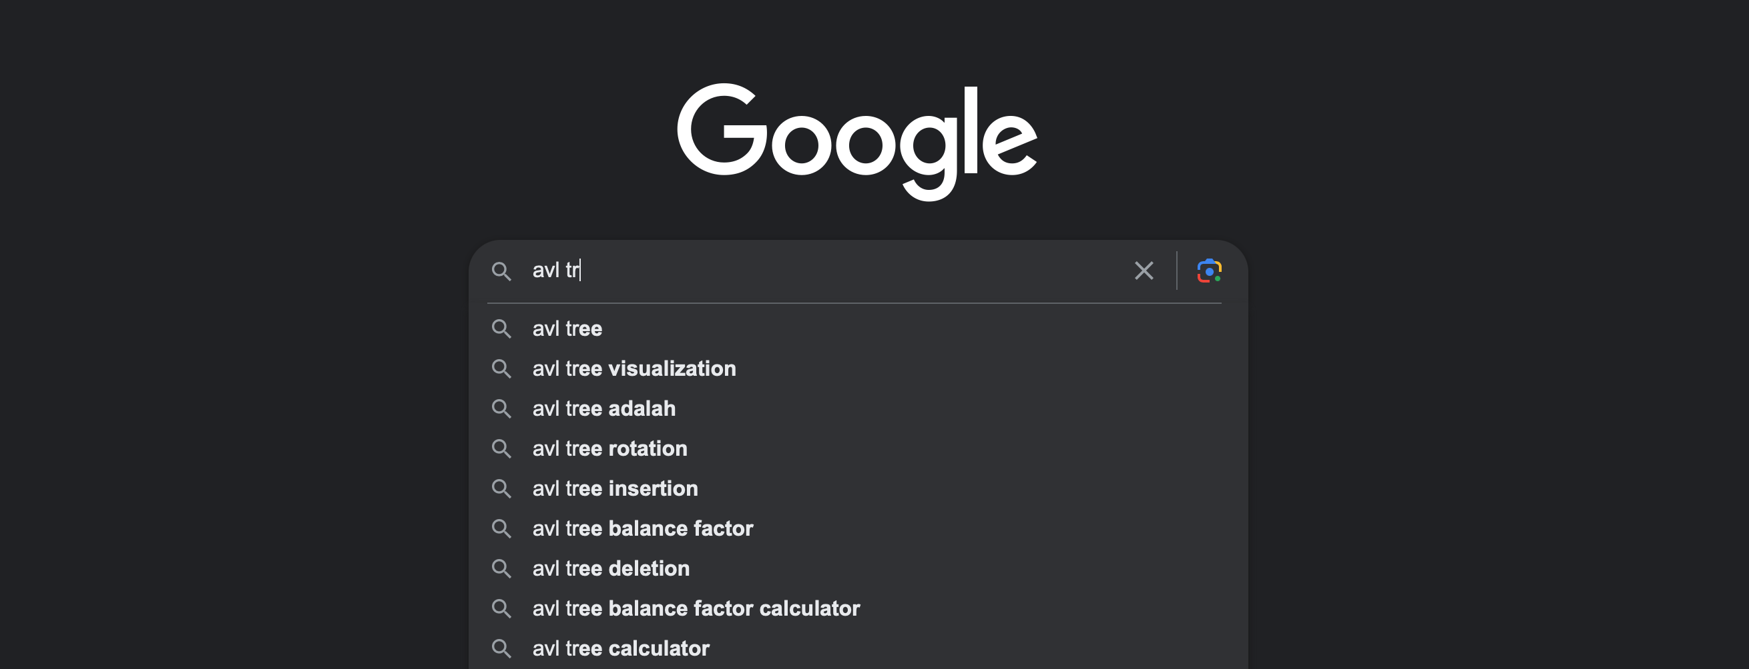
Tries concept & applications
Applications
Have you ever wondered how Google auto complete your search?

Slide 6
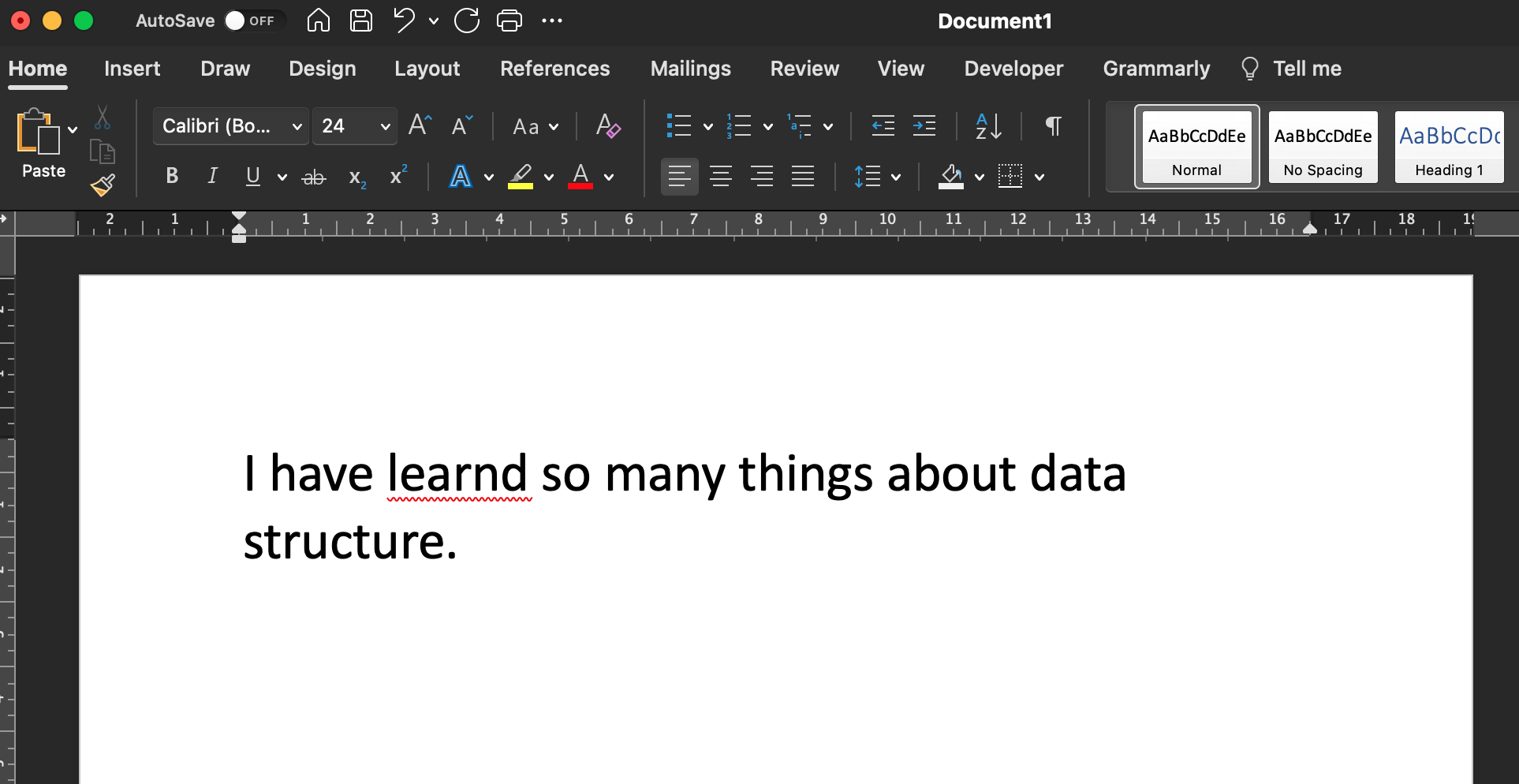
Tries concept & applications
Applications
Or how Word knows if you type misspelled words?

Slide 7
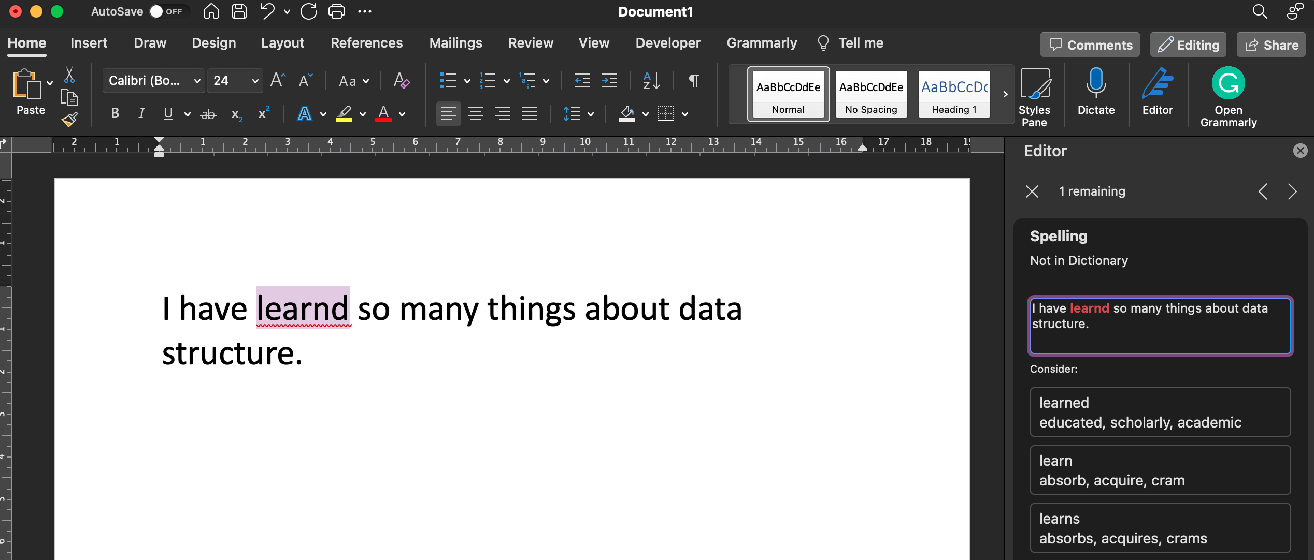
Tries concept & applications
Applications
On top of that, Word can suggest a few words to correct it. How?

Slide 8
Tries concept & applications
Concept
The data structure we commonly use when we need to find entries that match a prefix string is known as a Trie (pronounced "tree" or "try").
The name comes from the word retrieval, which indicates that this structure is designed for search and retrieval operations, specifically searching for things that match a prefix string.

Slide 9
Tries concept & applications
Concept
A trie is a type of tree structure that have many children (n-ary trees).
Trie stores keys and associated value.
The key is always a string, but value can be any type.
The root is associated with the empty string.
All the descendants of a node have a common prefix of the string associated with that node.

Slide 10
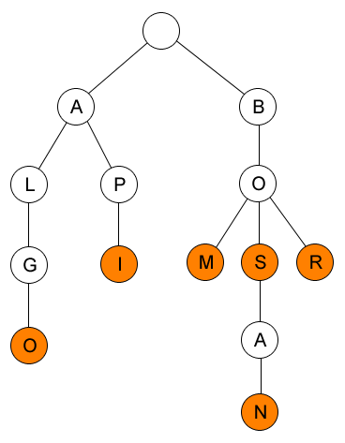
Tries concept & applications
Concept
Example of a trie that contains words:
ALGO
API
BOM
BOS
BOSAN
BOR

Slide 11
Tries Operations
There are some operations that can be done with trie, but we will cover the main operations only:
Insert
Find Word
Find Prefix

Slide 12
Tries Operations
Insert
There are 3 cases in insert:
The string is not in the trie -> In this case, create a new node for each character.
The string is already in the trie as prefix -> In this case, traverse through the prefix, then create new node for the rest of the characters.
The string is already in the trie -> In this case, traverse through the string in the trie until word == 1, then do nothing.

Slide 13
Tries Operations
Insert
The algorithm to insert string str into a trie is below:
Start from root, check if the current node has edge with the letter of the first letter of the string str.
If current node doesn’t have, then make a new node of that letter and recursive insert to the new node, passing the rest of the string str.
If current node have, then recursive insert to that child, passing the rest of the string str.
If there is no more string to pass (EOF), then set current node is a word.

Slide 14
Tries Operations
Insert
INSERT(“ALGO”)
ALGO
LGO
GO
O
EOF
No edge A, make newNode
A
A
A
A
Recursive to A, pass LGO
No edge L, make newNode
L
L
L
Recursive to L, pass GO
No edge G, make newNode
G
G
Recursive to G, pass O
No edge O, make newNode
O
Recursive to O, EOF, so set word = True

Slide 15
Tries Operations
Insert
INSERT(“API”)
API
PI
I
EOF
A
There is edge A
A
No edge P, make newNode
A
No edge I, make newNode
A
Recursive to A, pass PI
Recursive to I, EOF, so set word = True
Recursive to P, pass I
L
L
L
P
L
P
G
G
G
G
I
O
O
O
O

Slide 16
TRIES OPERATIONS
FIND
For finding a word from the trie, we can do it recursively just like the insert function.
The differences are instead of making a newnode, we return false and instead of setting word = 1, we return true:

Slide 17
TRIES OPERATIONS
Find PREFIX
Now, instead of only knowing whether the word is in the trie or not, we want to list out all possible words that have a certain prefix.
This is basically how Google autocomplete works.

Slide 18
TRIES OPERATIONS
find PREFIX
WORD = “A”;
Locate the last character of the prefix location in the trie.
The last character of the prefix (A) location in the trie is found.
Starting from A, traverse through all the edge and print the word if word = 1
A
A
A
A
L
P
L
P
L
P
L
P
G
I
G
I
G
I
G
I
O
O
O
O

Slide 19
References
S. Sridhar. 2015. Design and Analysis of Algorithms. Oxford University Press. New Delhi. ISBN: 9780198093695. Chapter 6
Reema Thareja. 2014. Data structures using C. Oxford University Press. New Delhi. ISBN:9780198099307. Chapter 11 & 12
Thomas H. Cormen, Charles E. Leiserson, Ronald L. Rivest, & Clifford Stein. (2009). Introduction to Algorithms. 03. The MIT Press. London. ISBN: 9780262033848. Chapter 6
Heap, https://visualgo.net/en/heap?slide=1
https://opendsa-server.cs.vt.edu/ODSA/Books/Everything/html/Heaps.html
http://tsao.wikidot.com/heap-explicit-implementation

